Slide 1
INVESTMENT CASE STUDY SUBMISSION
Group Name:
Gaurav Soni
Shishir Panchal
Sovan Sur
Tanisha Bhattacharyya

Slide 2
Abstract
The Purpose of this analysis was to understand the global trends in investments ,so that Spark Fund , an asset management company can invest .The Objective is to identify the best sectors, countries, and a suitable investment type for making investments. The overall strategy is to invest where others are investing, implying that the 'best' sectors and countries are the ones 'where most investors are investing'.
Considered two major constraints for investments from Spark Fund.
The investment should be between 5 - 15 millions USD per round .
Only invest in English Speaking Countries because of ease of communications with the companies.
The Strategy followed is to analyse real investment data from crunchbase.com and the insights are really incredible.Started with the data cleanup activity , cleaned all the data which is not relevant for the exercise .
The approach followed are completed in 4 major steps:
Investment type analysis: Compared the typical investment amounts in the venture, seed, angel, private equity etc. so that Spark Funds can choose the type that is best suited for their strategy.With this exercise venture is shortlisted as best suited.
Country analysis: Identified the countries which have been the most heavily invested in the past. The countries shortlisted are United States, United Kingdom & India.
Sector analysis: Identified the distribution of investments across the sectors for Countries and Investement Type Shortlisted.
Graph analysis : To communicate information clearly and efficiently, graphs are drawn to visually communicate a quantitative message.
The results from this exercise is quite satisfactory and impressive , and that concludes ,US, UK & INDIA are best Countries to invest in Sectors like Others, "Social Finance ,Analytics ,Advertising" ,"Clean Tech Semiconductors" & "News Search & Messaging" .

Slide 3
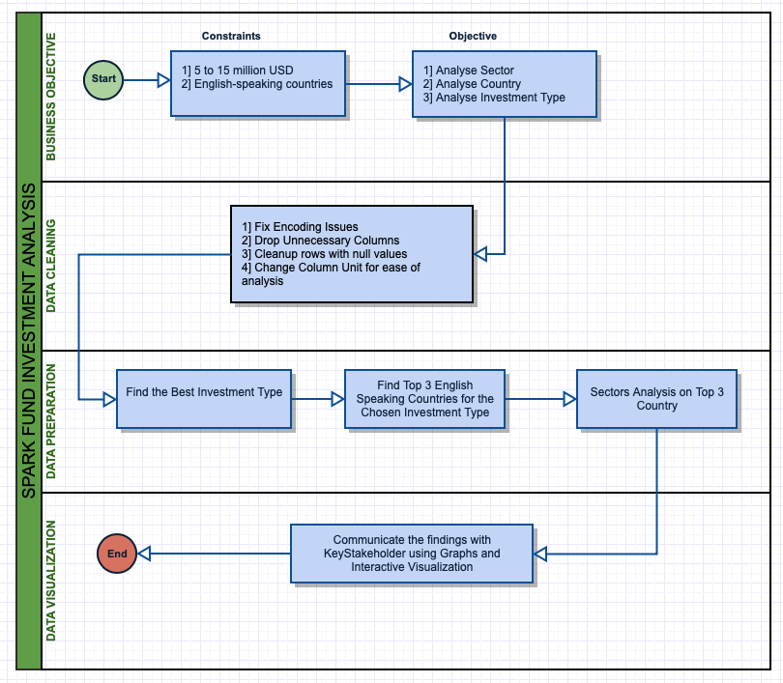
Problem Solving Flow Diagram
Use flow chart

Slide 4
Business & Data Understanding
Business Objective :
Spark Fund – An asset management company want to Invest between $5M to $15M USD ( $5M & $15M Inclusive ) in English speaking countries in the best sectors for suitable investment type.
Spark Fund
$5M to $15M USD
Fund Type
English Speaking Country
Best sector
Best company
Investment Decision
Data Understanding:
Data Source : crunchbase.com
Data Attributes & Observation:
Companies
Company Unique ID
Company Name
Round2
Company Unique ID
Funding Round type
Mapping
Sector Classification
Website URL
Categories
Status
Country Code
State Code
Funding Round ID
Funding Round Code
Funding time
Raised amount
Observation :66367
Obseravations:114948

Slide 5
Data Preparation & Analysis
Companies.txt
EXTRACT
ENCODING-ISO 8859-1
DECODING- ASCII
INSPECT
INFO
SHAPE
DESCRIBE
INSPECT
INFO
SHAPE
DESCRIBE
EXTRACT
ENCODING-ISO 8859-1
DECODING- ASCII
Round2.csv
MASTER_FRAME
Insepect
Remove Columns
Remove NA values
Analyze & find best funding type
Extract English Speaking country & Add language & country to Master frame
Create Data frame
For TOP9 & TOP3
Create Primary Sector column
Map & create main sector column
Extract D1 , D2 & D3 DATAFRAME & Analyze
Merge to Master Frame

Slide 6
Reporting
After doing the analysis we get
Master_Dataframe
D1
D2
D3
Plotting
For Plot 1
We found the ‘Average Raised Amount’ and plotted it against ‘Funding Round Type’ for venture, seed, and private equity to find out the best suited funding type for Spark Fund.
For Plot 2
We take ‘Total Raised Amount’ and ‘Country_Name’ for English as Official Language Countries, indexed them on country code and found the top 9 countries .
For Plot 3
We used the master_dataframe and made a calculation_field to get ‘Raised Amount’counts between 5-15 million and plotted against Main sector and after indexing them based on Country Code and Main Sector found the top 3 countries and top 3 sectors of each of them.

Slide 7
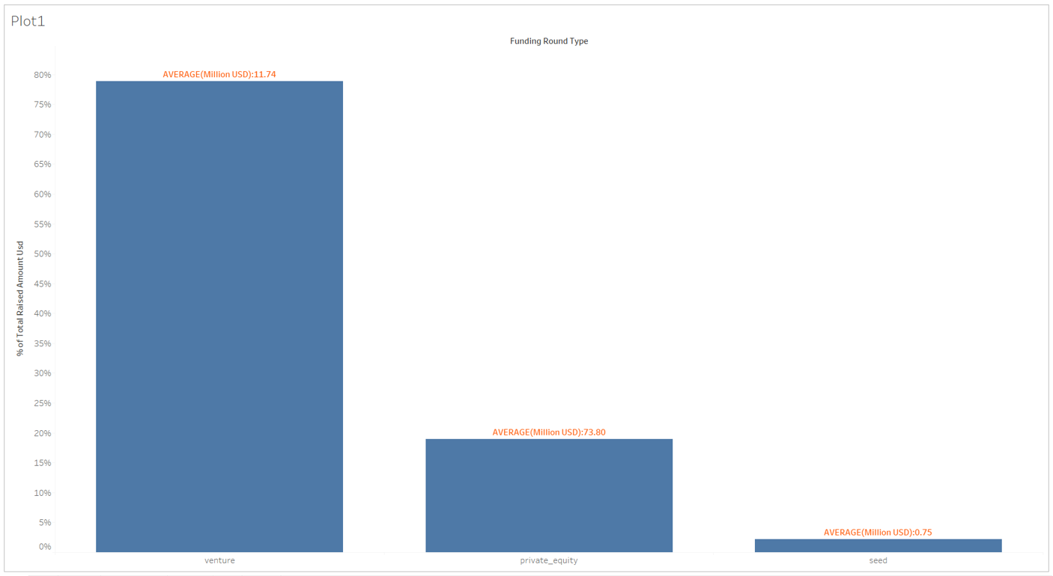
Investments in Venture, Seed & Private Equity
Plot 1

Slide 8
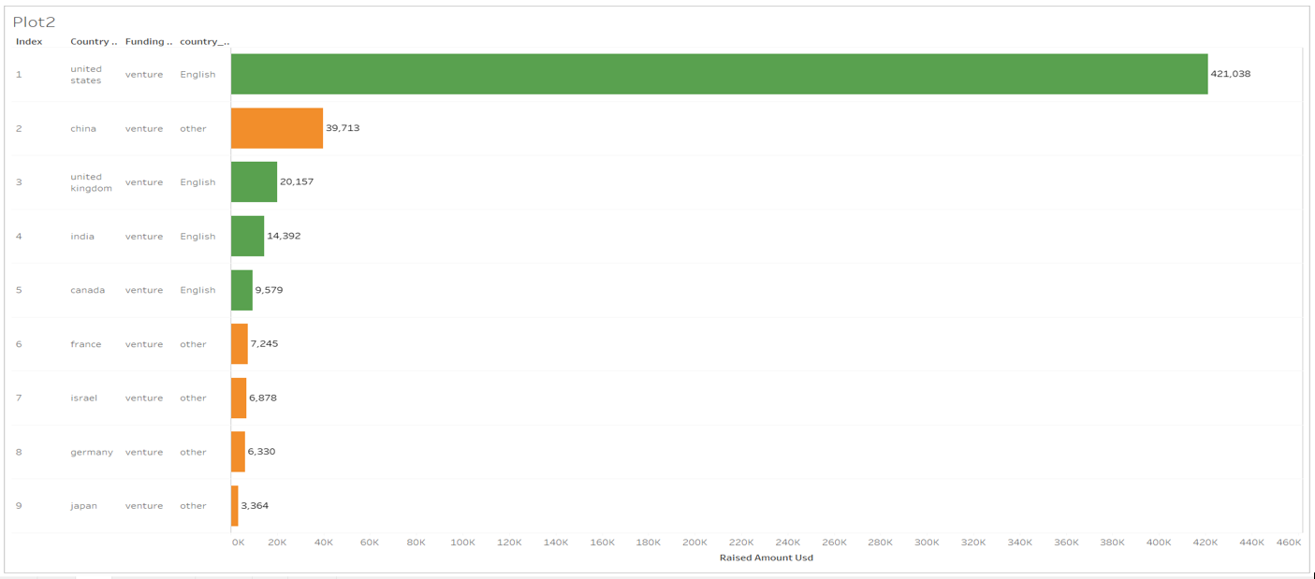
Top 9 countries against Venture Total Amount

Slide 9
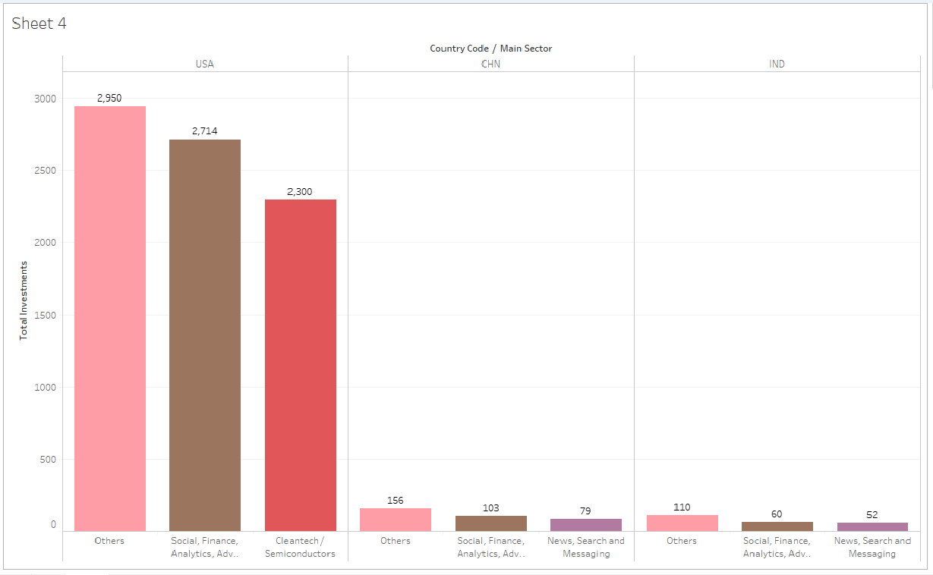
Investments of Top 3 Sectors of Top 3 Countries

Slide 10
Conclusion
From our Analysis we can conclude that
For English as Official Language Countries and Raised Amount between 5 to 15 million and Venture as Funding Round Type
USA UK and India are top three countries for Investment respectively .
Top three main sectors for USA are ‘Others ‘, ‘Social, Finance, Analytics, Advertising’ and ‘Clean Tech Semiconductors’ respectively .
Top three main sectors for UK are ‘Others ‘, ‘Social, Finance, Analytics, Advertising’ and ‘Clean Tech Semiconductors’ respectively .
Top three main sectors for India are ‘Others ‘, ‘Social, Finance, Analytics, Advertising’ and ‘News Search and Messaging’ respectively .
VIRTUSTREAM , ELECTRIC CLOUD and FIRSTCRY.COM received the most Investment from USA,UK and India respectively

